Slide 1
Dc/ac converter
Mark Labib
Josh Knight
Prita Akhter
Geordie Stogdon

Slide 2
INTRODUCTION
What is an H-bridge?
The H-bridge (full-bridge) is an electronic circuit that can operate in the four quadrants of the current-voltage plane on the load. In other words, voltages and currents on the load can be indifferently positive or negative.
Objectives:
To work as an individual and as a member of a team while working on an electronics project.
To design, simulate and physically implement four different DC to AC converters for multiple and/or variable frequencies and amplitudes.
To analyse the behaviour of the relevant DC to AC converters operating in various conditions.
To effectively communicate design, implementation and analysis undertaking for the completion of the project.

Slide 3
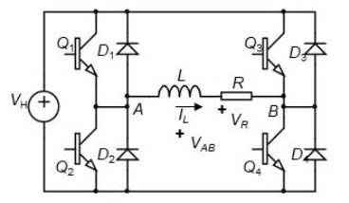
HARDWARE/CIRCUITRY
As previously discussed, the circuit configuration used is the H-Bridge, this circuit can be used as a 4-quadrant DC-DC converter and as a DC-AC converter by applying varying PWM signals to the transistors.
Parts given for use…
4x BC107 NPN Transistor
10 mH Inductor
4x 1N4001 Silicon Diodes
Arduino Uno, Relevant Wires, and Breadboard
The circuit was constructed according to the above circuit diagram.
A pulse width modulation signal is applied to the base of the transistors, alternating between Q1 and Q4 then Q2 and Q3.
This applies the Arduinos 5 Volt signal to the resistor and inductor in an alternating pattern.
A carrier frequency is used which is calculated using the time constant of the RL combination. This allows the amplitude of the AC waveform to be defined according the waveform that is being produced.
This is achieved by varying the duty cycle of the PWM signal based on the desired amplitude of the output voltage waveform.
The BC107 datasheet indicates that the Collector-Emitter voltage is 0.6 Volts when transistor is saturated. The 1N4001 diodes also have a forward voltage of 1.1 Volts.
Because of these voltage drops we know that there will be an overall drop within the circuit which will reduce the amplitude of the output AC waveform.

Slide 4
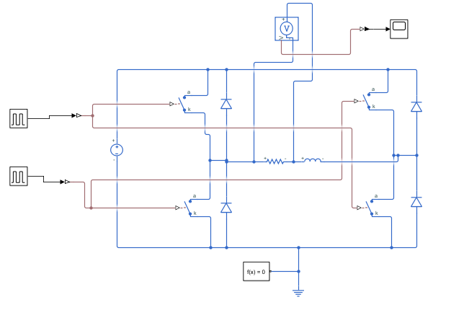
TASK 1
DC/AC RECTANGULAR WAVE CONVERTER:
Square wave signal of frequency 10 Hz and 10 V peak-to-peak amplitude
Extension – varying frequency
Limitations:
Peak-to-peak voltage is lower than expected due to the high resistance of the inductor (expected peak-to-peak amplitude = 5.7 V)
Other losses are not taken into account (such as transistor's and diode's resistances), resulting in a lower peak-to-peak voltage.
Extension limitations: frequency cannot be lower than 1 Hz

Slide 5
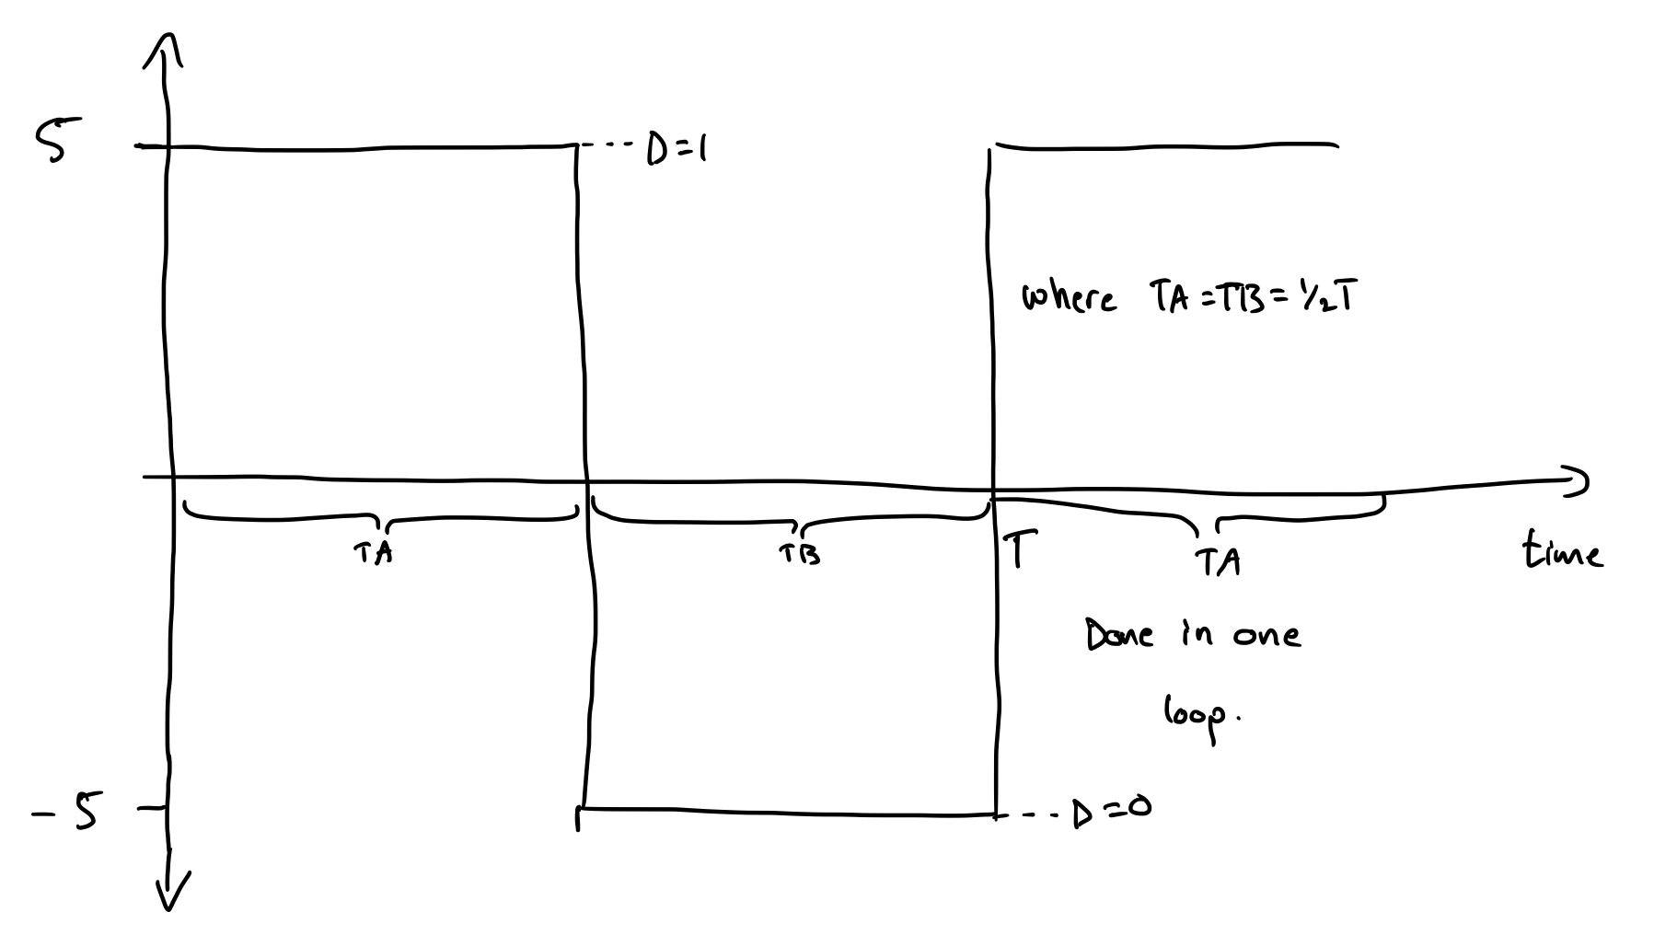
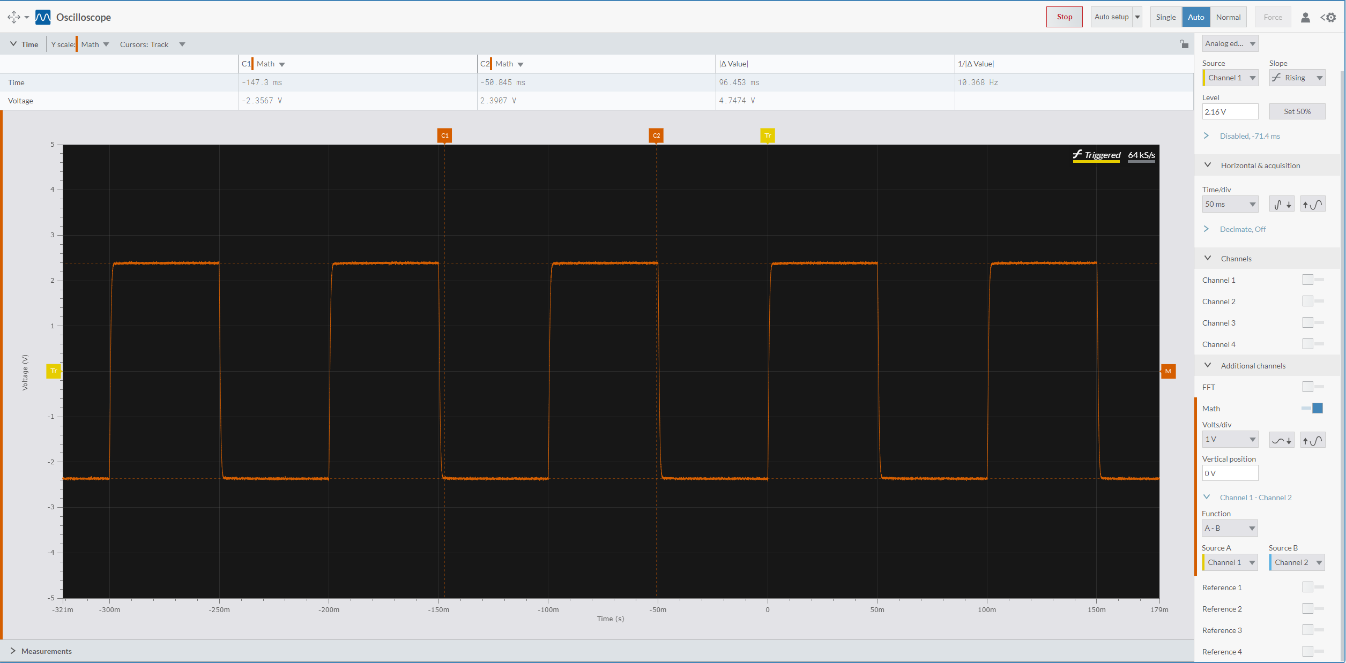
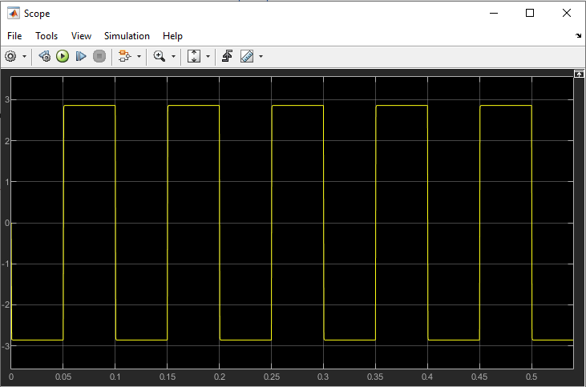
Task 1 – Diagrams
Below are two oscilloscope readings comparing our simulation results (bottom right) and our observed results (bottom left)
On the top right is a diagram that was used to help visualize the coding process behind the waveform

Slide 6
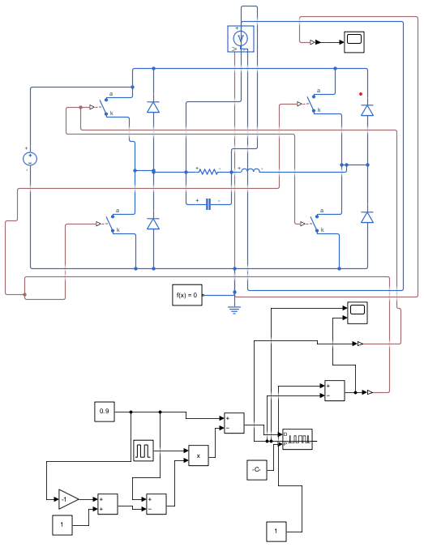
TASK 2
DC/AC RECTANGULAR WAVE CONVERTER:
Square wave signal of frequency 60 Hz
8 V peak-to-peak amplitude generated using PWM
Extension – varying frequency and amplitude
Limitations:
Carrier frequency must be higher than 5 kHz (for 50 Ohm resistor)
Peak-to-peak voltage is lower than expected due to the high resistance of the inductor (expected peak-to-peak amplitude = 4.6 V)
Other losses are not taken into account (such as transistor's and diode's resistances), resulting in a lower peak-to-peak voltage.
Extension limitation - modular frequency cannot be below 1 Hz
Extension limitation - peak-to-peak amplitude cannot go above 10 V (with other limitations 5.7 V)

Slide 7
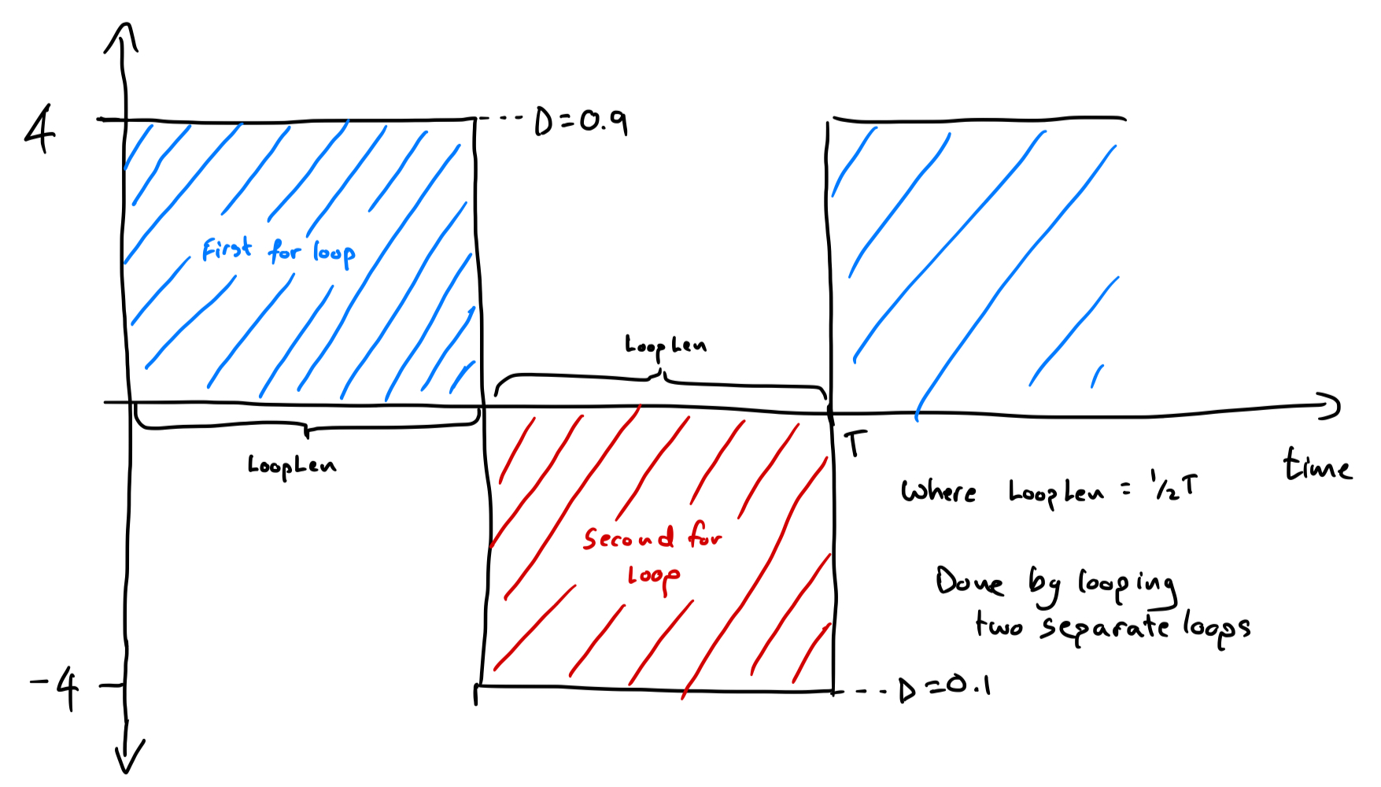
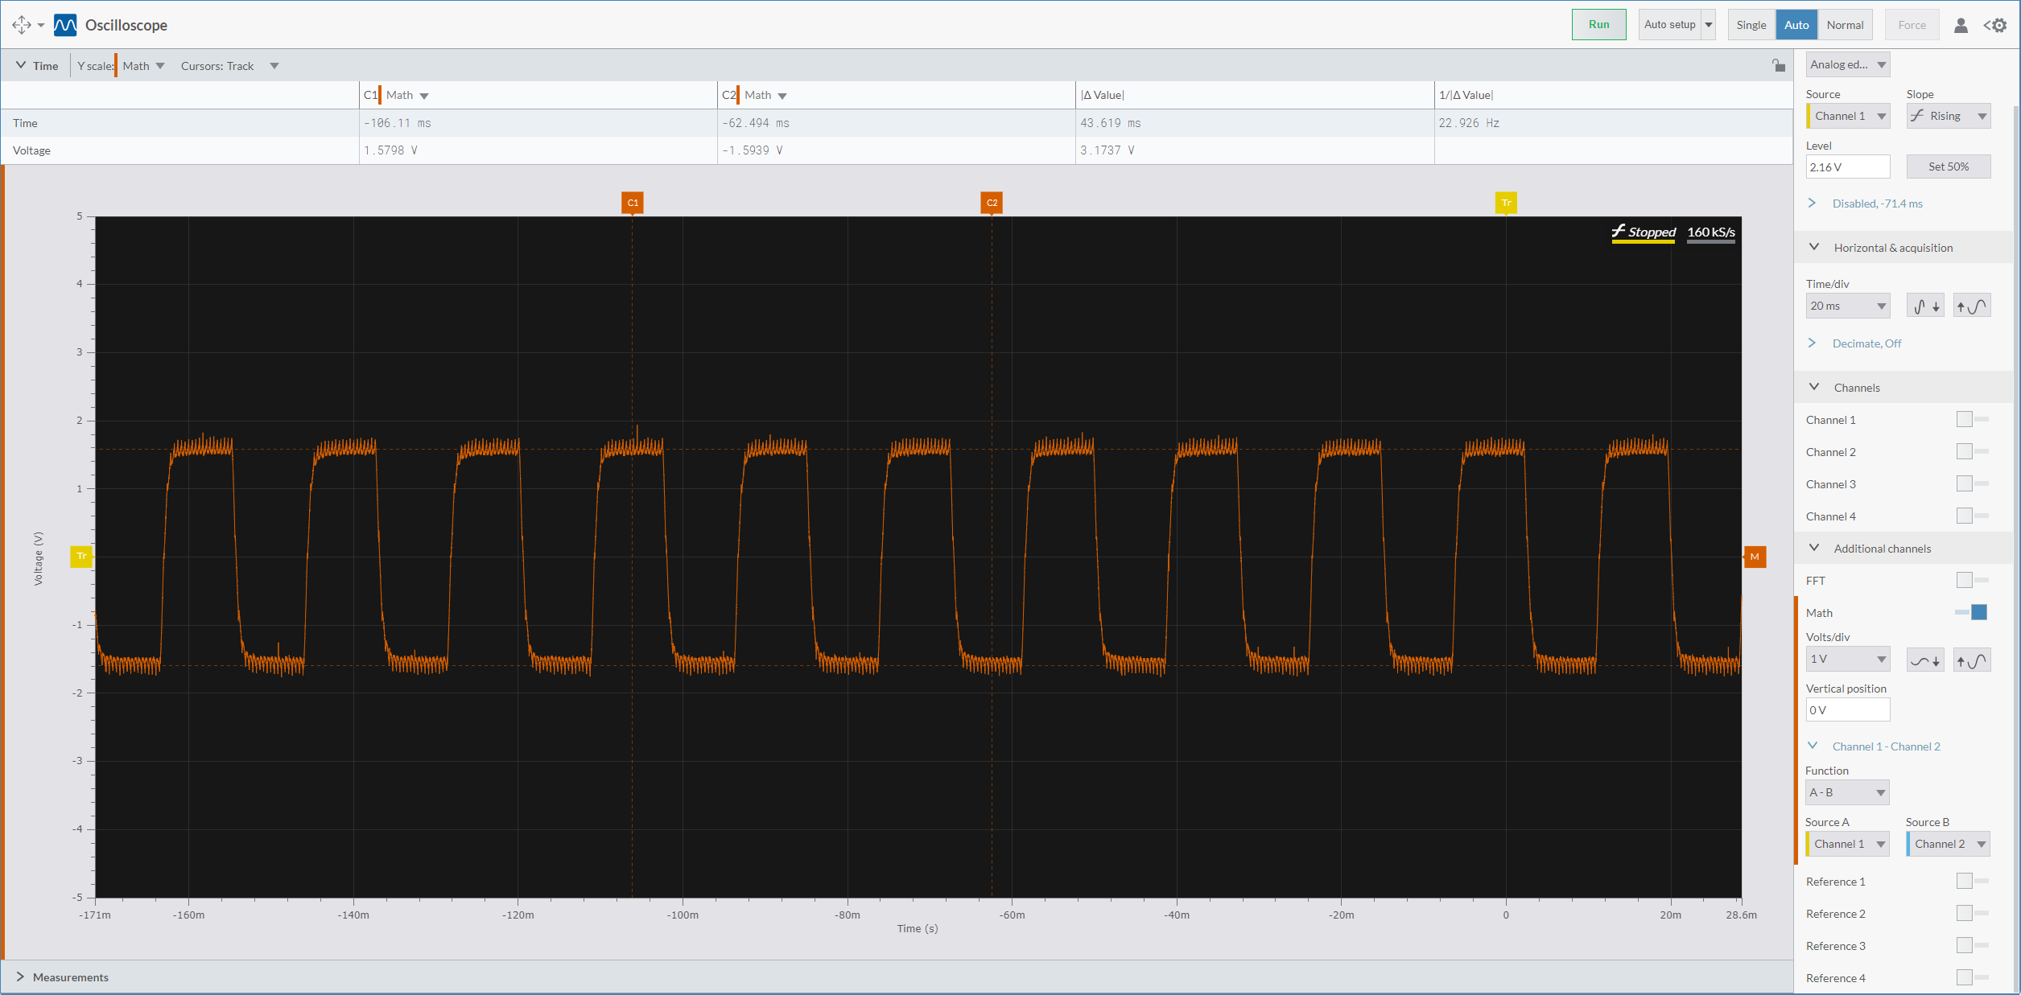
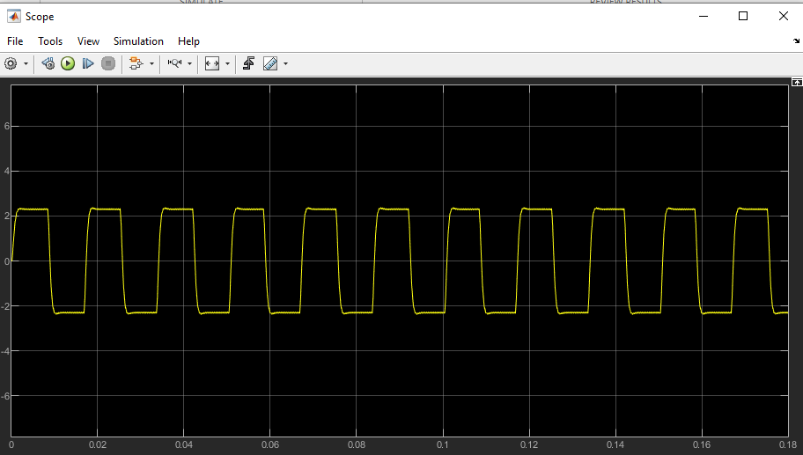
Task 2 – Diagrams
Below are two oscilloscope readings comparing our simulation results (bottom right) and our observed results (bottom left)
On the top right is a diagram that was used to help visualize the coding process behind the waveform

Slide 8
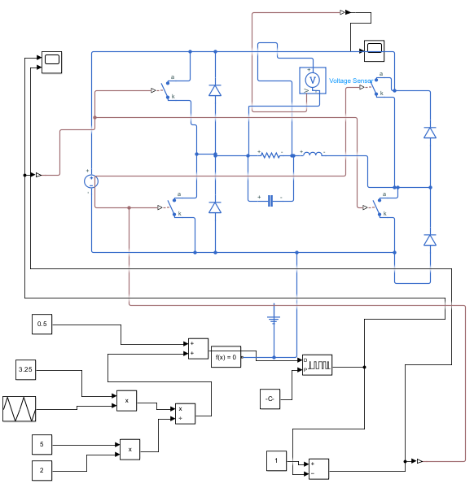
TASK 3
DC/AC TRIANGULAR WAVE CONVERTER:
Triangle wave signal of frequency 100 Hz and 6.5 V peak-to-peak amplitude
Extension – varying frequency and amplitude
Limitations: ​
Peak-to-peak voltage is lower than expected due to the high resistance of the inductor (expected peak-to-peak amplitude = 3.7 V)​
Other losses are not taken into account (such as transistor's and diode's resistances), resulting in a lower peak-to-peak voltage.​
Carrier frequency cannot be below 5kHz
Extension limitation - modular frequency cannot be below 1Hz
Extension limitation - peak-to-peak amplitude cannot go above 10 V (with other limitations 5.7V)

Slide 9
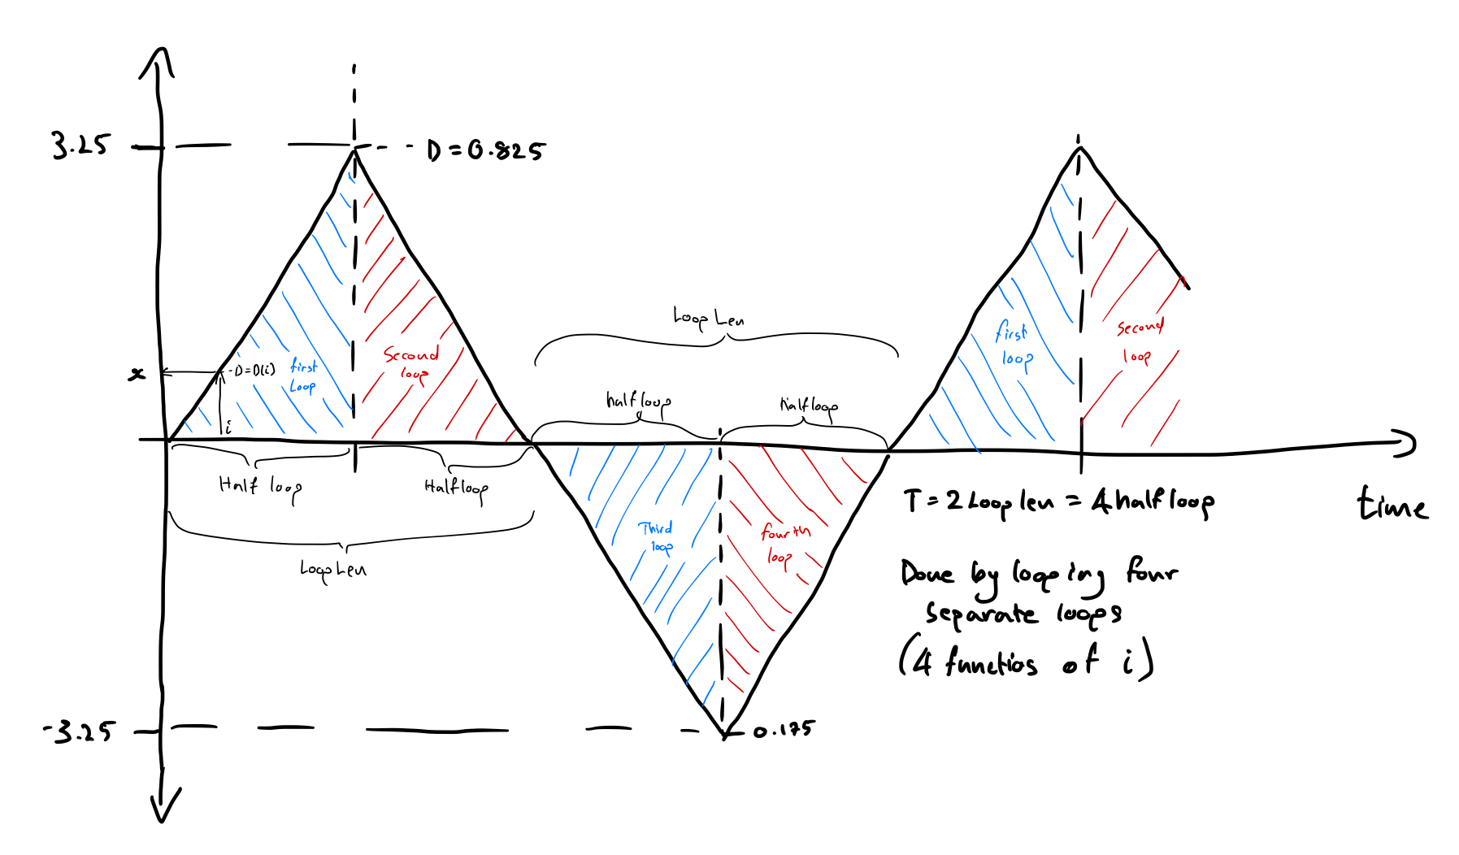
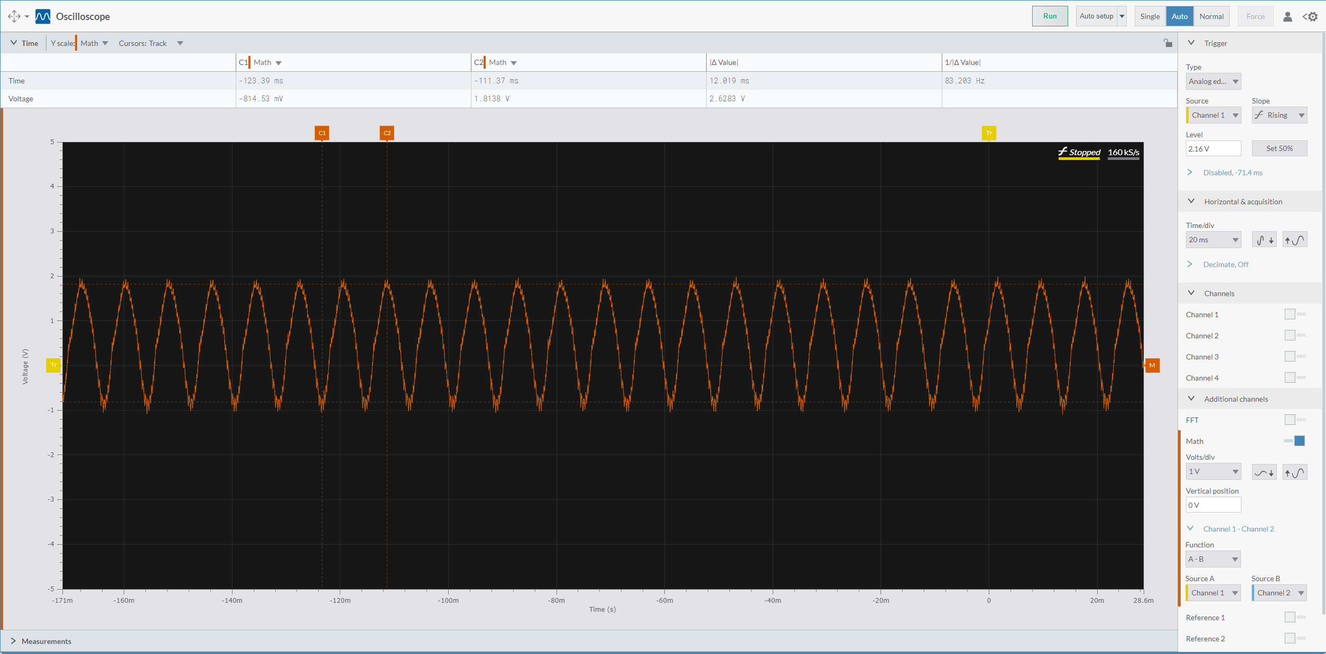
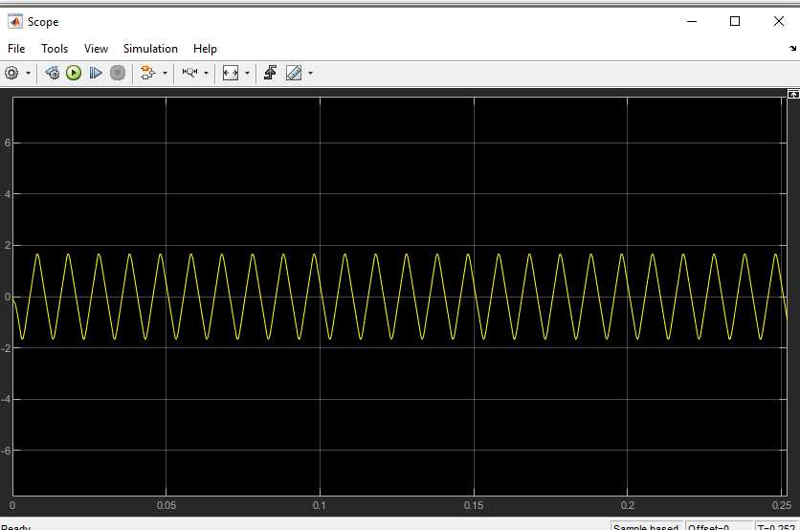
Task 3 – Diagrams
Below are two oscilloscope readings comparing our simulation results (bottom right) and our observed results (bottom left)
On the top right is a diagram that was used to help visualize the coding process behind the waveform

Slide 10
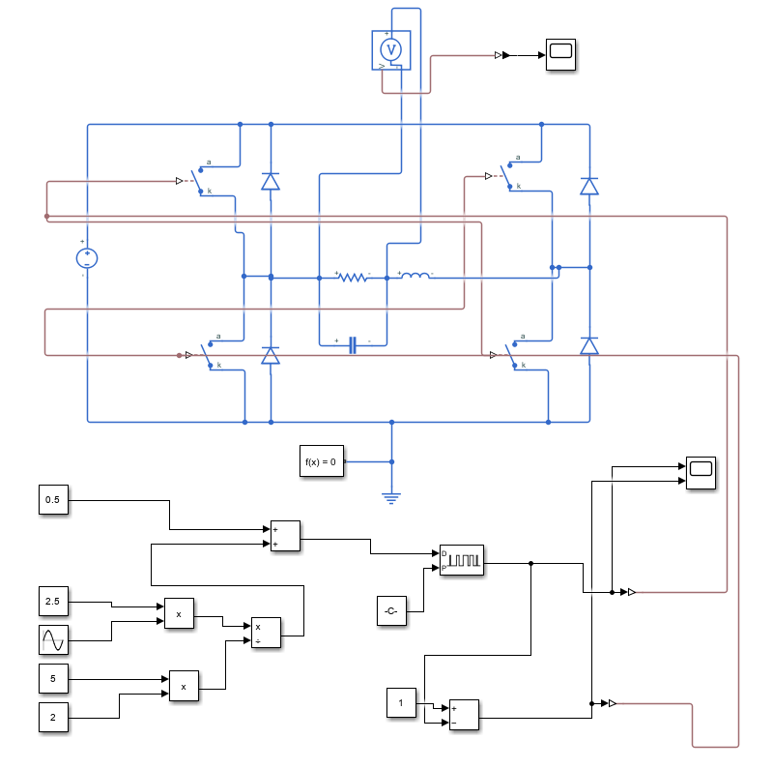
TASK 4
DC/AC SINE WAVE CONVERTER:
Sine wave signal of frequency 80Hz and a 5V peak-to-peak amplitude.
Extension - triangular wave form with varying frequency and amplitude
Limitations: ​
Peak-to-peak voltage is lower than expected due to the high inductor resistance (expected peak-to-peak amplitude= 2.8V)
The theoretical peak-to-peak amplitude is higher since the losses at the resistor, transistors and other components are not accounted for.
Carrier frequency cannot be lower than 5 kHz
Extension limitation - modular frequency cannot be below 1Hz
Extension limitation – peak-to-peak voltage cannot go above 10V (with other limitations 5.7V)

Slide 11
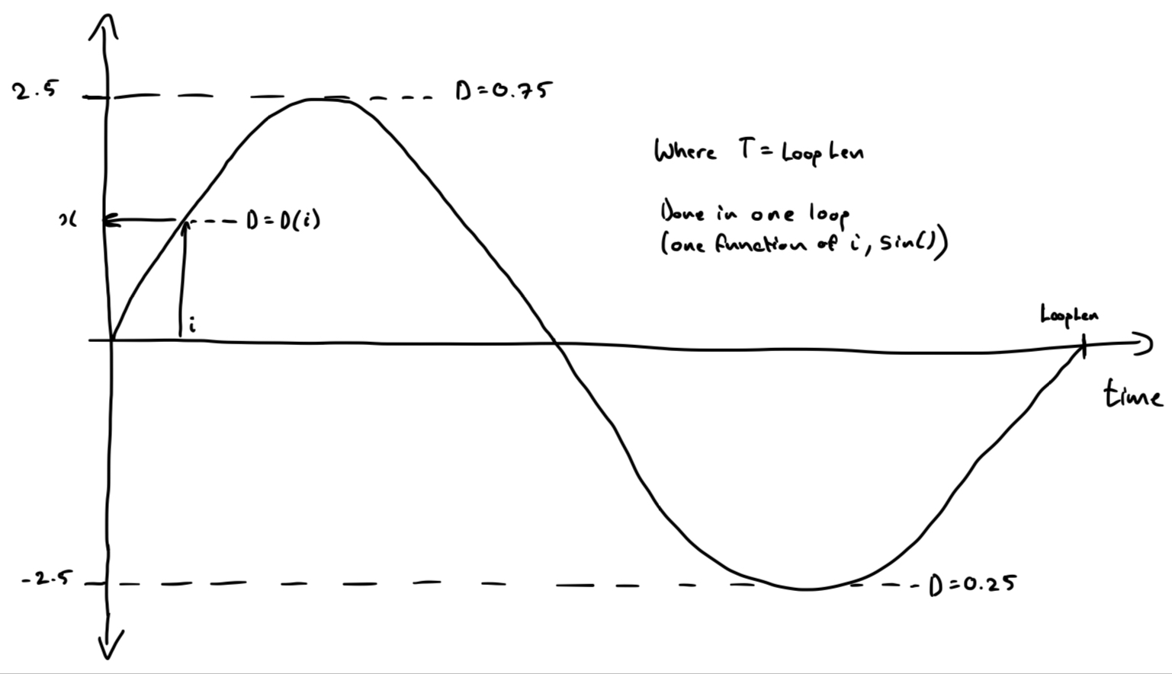
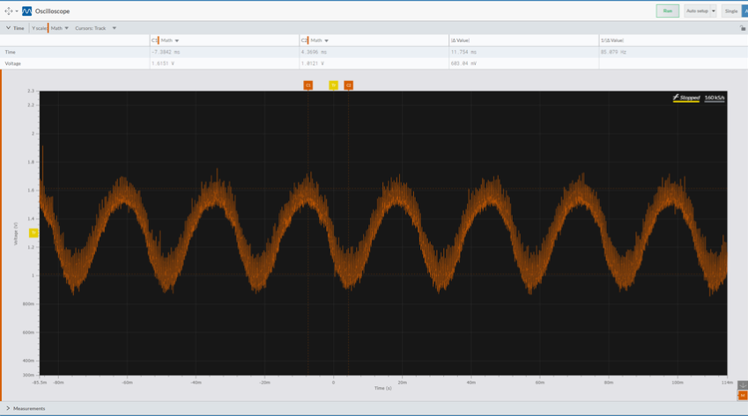
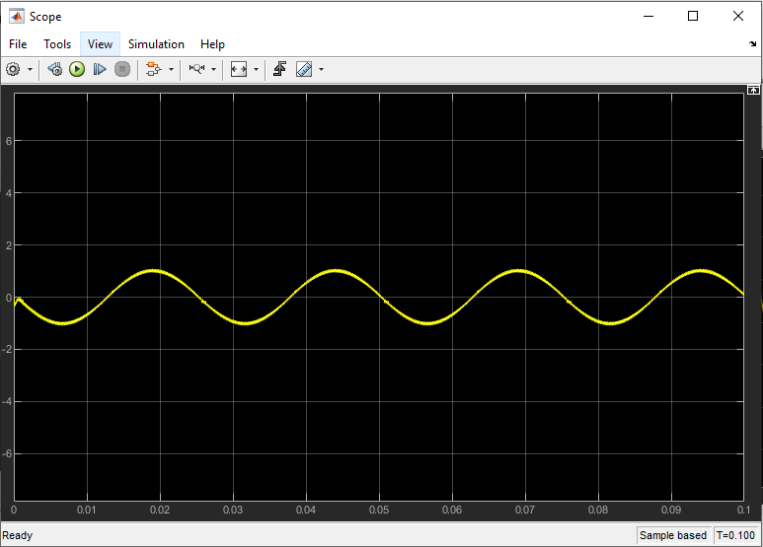
Task 4 – Diagrams
Below are two oscilloscope readings comparing our simulation results (bottom right) and our observed results (bottom left)
On the top right is a diagram that was used to help visualize the coding process behind the waveform

Slide 12
THANK YOU!

